Slide 1
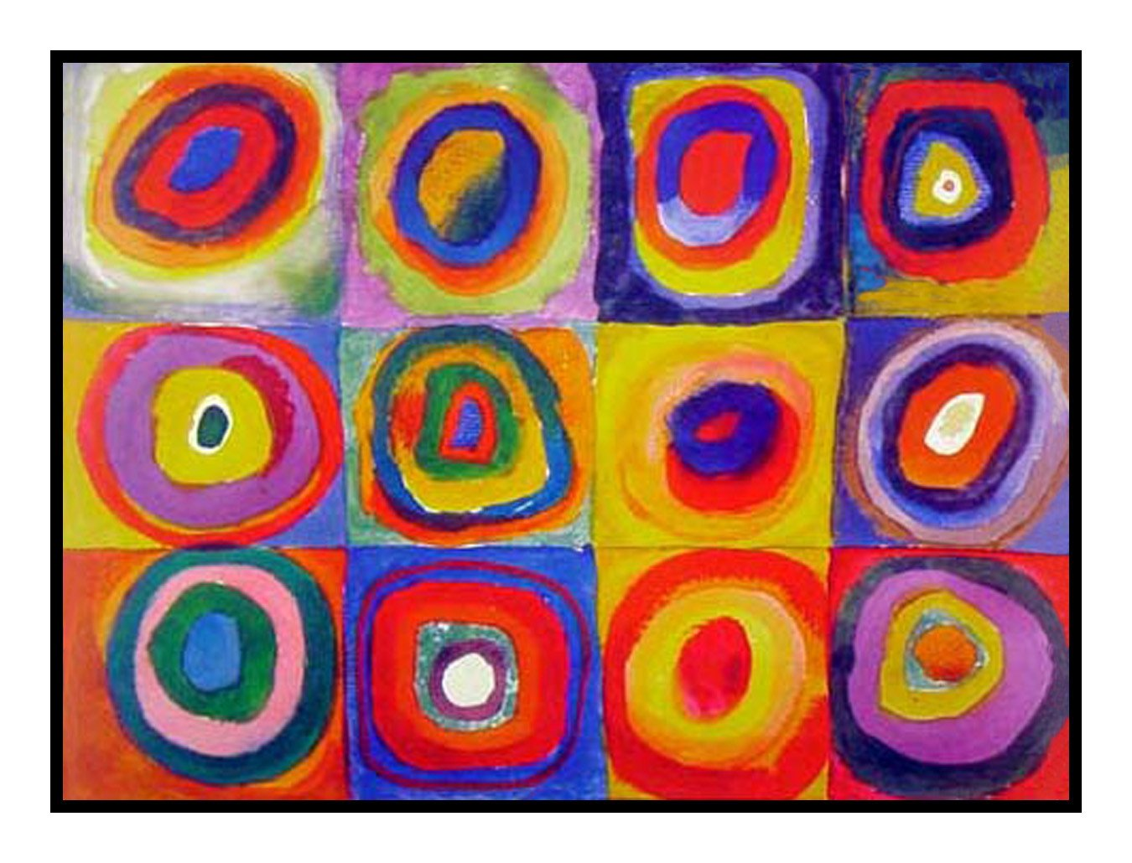
Image Chordifier
CMLS Spring 2021 //Group 9

Slide 2
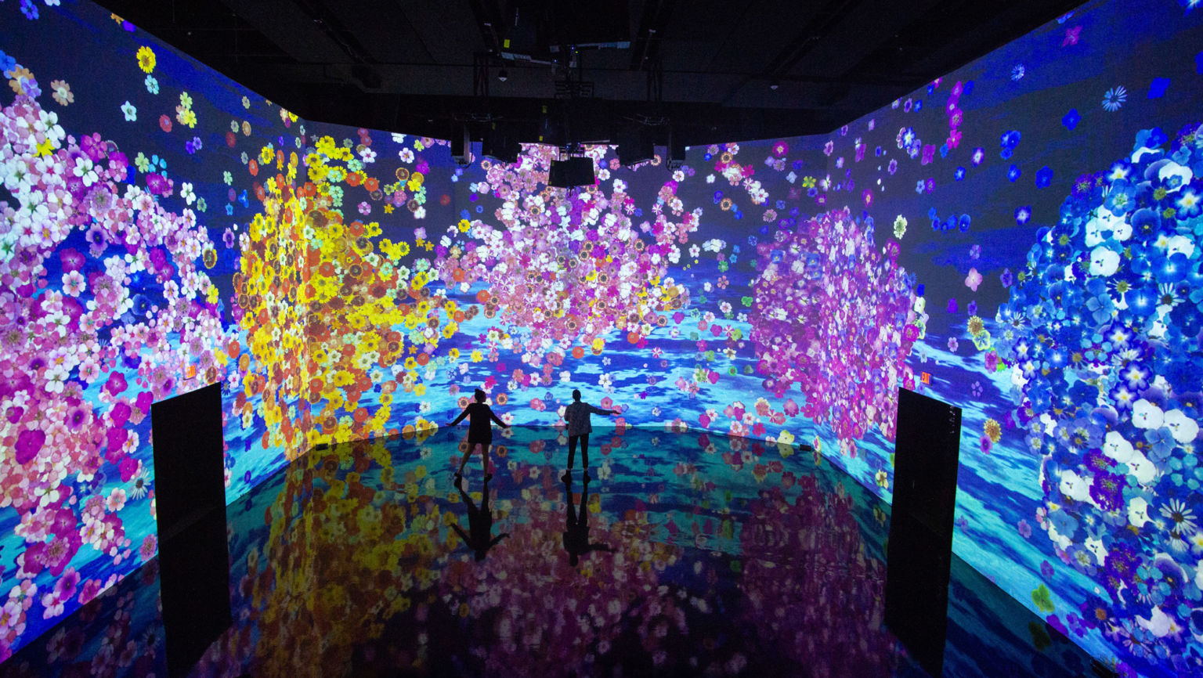
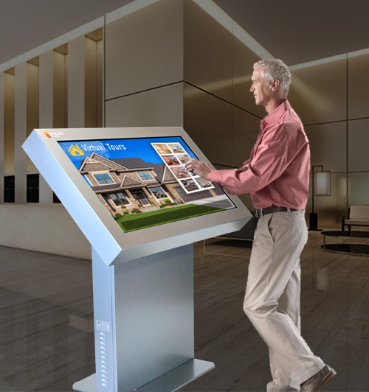
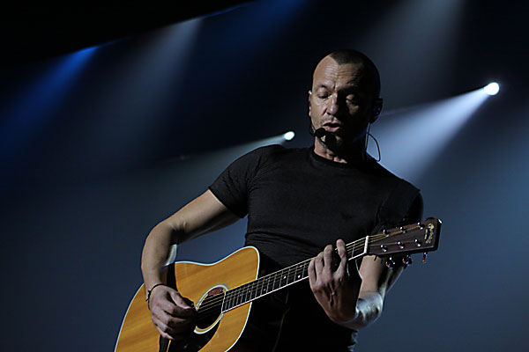
Meet the “Image Chordifier”
Innovative instrument that associates color and harmony
Given an image, and selected a pixel, a chord is generated and played back
When cursor is moved, chord is updated
Use cases include interactive website design, creative music production, interactive kiosks, art installations
Notes:
MARCO

Slide 3




Implementation Overview
Processing
Supercollider
Hue
Brightness
Saturation
Additive Synth (5 voices)
OSC
GUI
ADSR/Filters
Sliders
Selection of Chords
Notes:
RIC
The GUI has been developed in Processing 3
When a pixel is selected, the Brightness, Hue and Saturation RGB values are sent to Supercollider via OSC messages
The Additive Synthesizer is implemented using 5 LFSaw oscillators and the mix function in Supercollider
The Reverb is implemented using the default reverb function in Supercollider
User can tweak the ADSR profile, LP cutoff and sliding(?) rate in the GUI

Slide 4
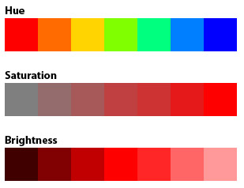
From Colors to Chords
KEY/ROOT
REVERB
CHORD TYPE
Notes:
RIC
The chord root is a function of Hue
The chord type is a function of Brightness
Reverb dry/wet ratio is a function of Saturation
High saturation = pure, vivid color -> pure sound = dry reverb
Low saturation = washed-out, dull color -> washed-out sound = wet reverb

Slide 5
Chord Types, and Brightness
 | Mode | Chord Type | Simplified Example | Numerical Representation
Brightest | Lydian | maj7#4 | C E F# B | 0 4 6 11
 | Ionian/Suspended | Sus4 etc | C F G D | 0 5 7 14
 | Ionian | maj7 | C E G B | 0 4 7 11
 | Mixolydian | 7 | C E G Bb | 0 4 7 10
 | Dorian | mi7 | C Eb G Bb | 0 3 7 10
Darkest | Melodic Minor | mi6 | C Eb G A | 0 3 7 9
Notes:
Tommaso
42 five-note-chords have been selected for a broad range of sounds; they have been written in musical notation and later brought into Supercollider as bi-dimensional array
Each chord is expressed as a vector of half-step offsets with respect to the root; this allows good flexibility and ease of transposition

Slide 6
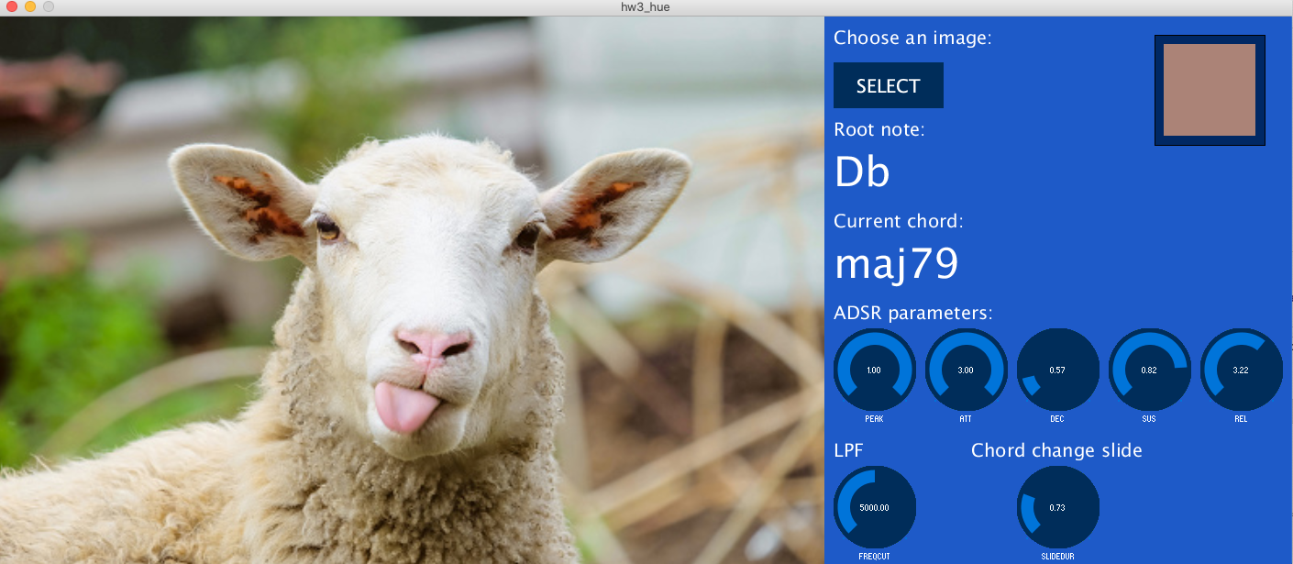
Demo
Notes:
Tommaso
42 five-note-chords have been selected for a broad range of sounds; they have been written in musical notation and later brought into Supercollider as bi-dimensional array
Each chord is expressed as a vector of half-step offsets with respect to the root; this allows good flexibility and ease of transposition

Slide 7
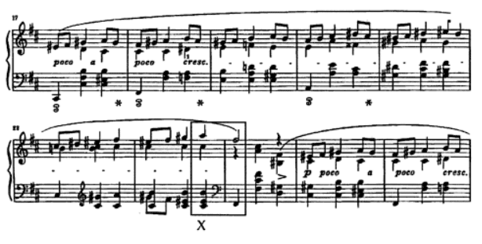

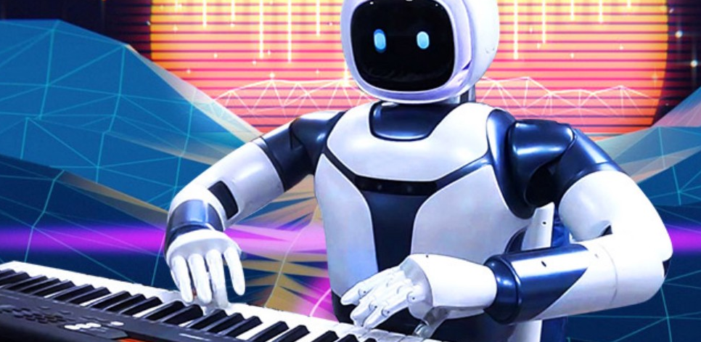
Further developments
Pool of Chords expansion
Porting code to Web-friendly framework
Machine Learning
Live video
Notes:
FRANCESCO
Expand the pool of chords
Port the code to a web-friendly framework
Implement a record function
Passing chords
Apply the concept to a live video stream: the average hue, brightness and tone of each frame are computed; new sounds are generated based on the video
Investigate the use of machine learning to come up with an even broader range of possible chords/intervallic combinations
Machine learning to associate colors+chords, even more directly
Machine learning to improve the chord progressions

